Slide 1

AMAZON an E-Commerce Website
Analysis on Power BI
SHWETA BISHT

Slide 2
DATA COLLECTION
PROJECT AIM: Amazon is performing well, but stakeholders are seeking strategies to maintain current sales levels and drive sales growth.
SOURCE: The Project is given by Newton School for Data Analysis.
METHOD: The Amazon dataset is downloaded from Newton School portal which were shared to us by Newton School .

Slide 3
DATA CLEANING
CHALLENGES:I found many null values in the Product Category column. To fill these blanks, I referenced the Product and Product Subcategory columns. By matching these two columns, I filled the null values in the Product Category column.
Additionally, I added the Customer Age from the Customer table into the Order table referencing a common
column ‘Customer ID’ present in both the table.
TECHNIQUES: For filling the null values, I use the Power Query features of Power BI. To add columns using a reference column from a table, I use the lookup function in Power Query of Power BI Desktop.”

Slide 4
DATA ANALYSIS
TOOLS AND APPROACH:
All Analysis is done using Power BI.
Net Revenue is a single value and shown in ‘card’.
Total number of Unique product is also shown in ‘card’.
Average delivery time is also shown in ‘card’’.
Total number of returned product is shown in gauge ‘chart’.
Sales growth in year from 2015 to 2019 is shown in a ‘line chart’ because it is a time dependency case putting year in Horizontal axis and unique customer in vertical axis.
Net revenue of a product category, its subcategory and product name is shown in a ‘Tree Decomposition’ chart because it is a Categorical data.
Revenue by location is shown in ‘bar chart’ taking Location in Horizontal axis and Sum of revenue in vertical axis.
To find the total number of returned product I have used a ‘bar chart’ taking Reason of return in horizontal axis and count of return in vertical axis.

Slide 5
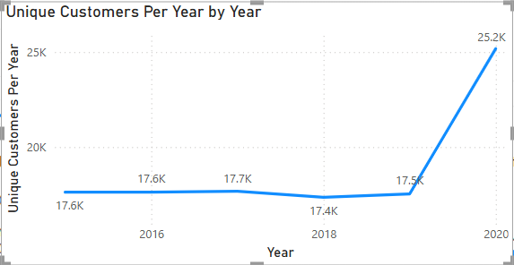
CUSTOMER EVERY YEAR
Drag the sale price into the chart and use a card to display the values.
Considering that the refund would have been issued for all the returned orders, filter the revenue only for the delivered order.

Slide 6
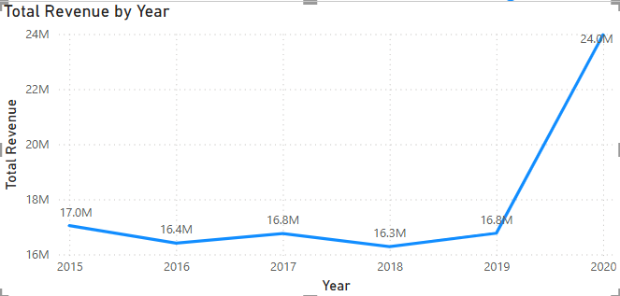
SALES PER YEAR
There has been increase and decrease in sales for all the products over the years.
But in common, all the products were bought more in 2020. Reason could be because of the pandemic.

Slide 7
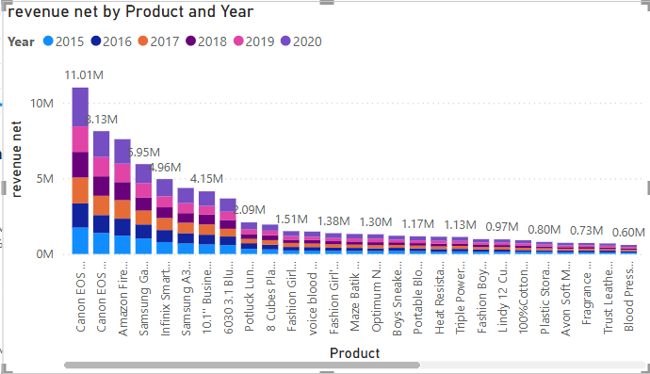
Total Revenue of each product each year
First visual depicts the total sales done by each product in each year. The most sold product being
“Canon EOS 600D 18MP CMOS DSLR Camera - Black” contributing 12.95% of the total sales and least sold product being “Hemani Ultra Slim Tea - 10 Bags” contributing to 0.01% of the total sales.

Slide 8
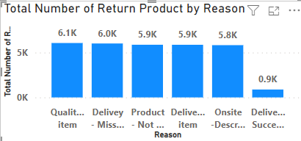
RETURNED ORDER COUNT BY REASON
There are totally 30.53K orders returned which is 26.85% of the total orders received.
Most of the orders where returned due to Quality or defective items 6.1k which contributes to 19.87% of the total returns.

Slide 9
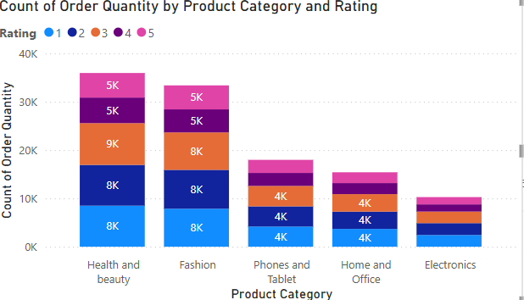
Order count by category and rating
Rating of 1,2 and 3 have been given to most of the products in each category which accumulates to 79K orders.
Rating of 4 and 5 have been given to only few of the orders in each category which only accumulates to 33K orders.

Slide 10
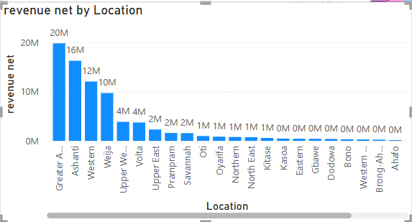
NET REVENUE IN EACH LOCATION
From the visual shown above, it is clear that from 26 location ‘Greater Accra’ is the location which contributes the highest revenue generation location.

Slide 11
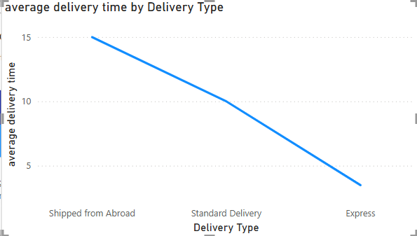
Average days taken to deliver by delivery type
Express delivery type seems to deliver the product in 3 days per order.
Whereas, shipping an order from abroad seems to take 15 days to reach the customer.

Slide 12
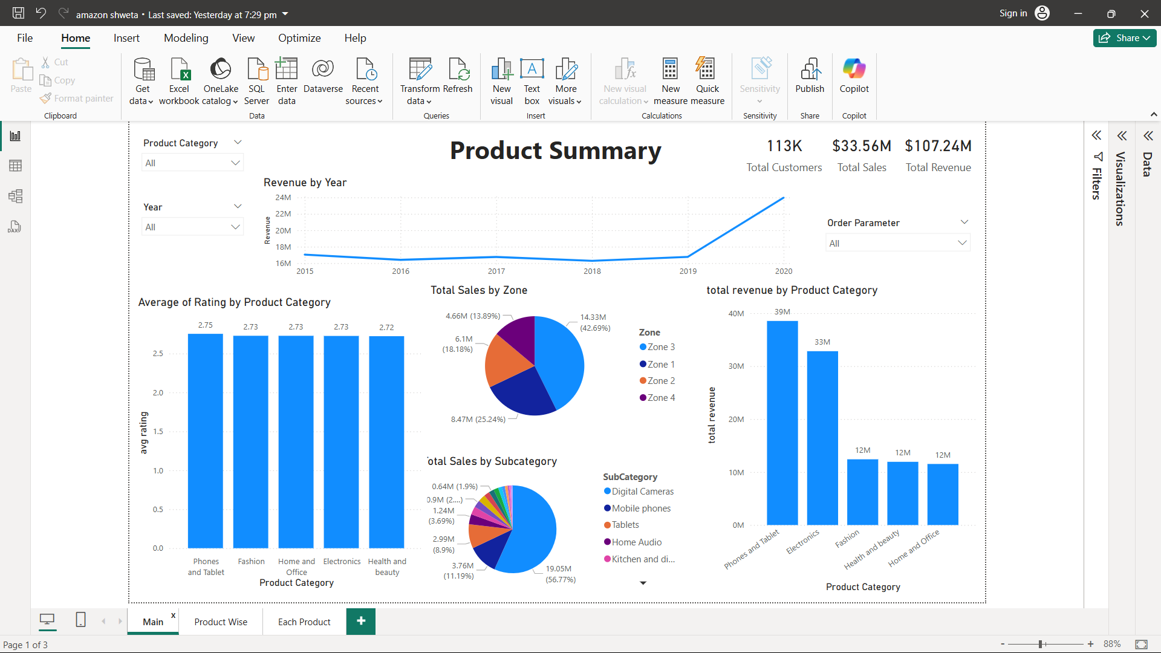
DASHBOARD

Slide 13
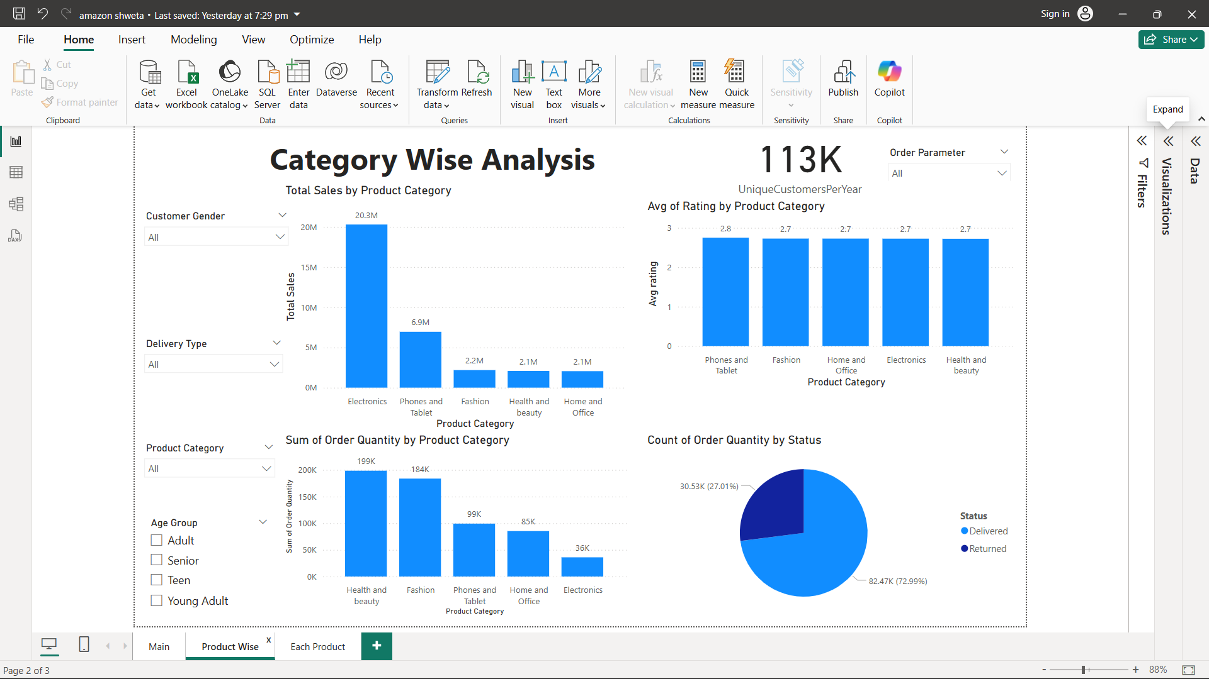
DASHBOARD

Slide 14
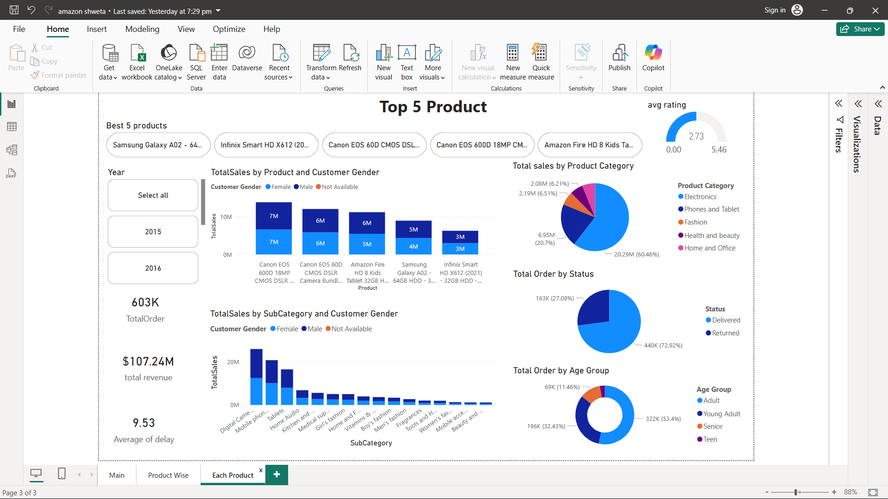
DASHBOARD

Slide 15
CONCLUSION
Net Revenue made by amazon is 78 Million.
Total Sales done by company is 107M.
Number of total products which were returned is 31K.
Average delivery time to deliver the products is 9days.
Unique customer per year by year is increasing from 2015-2018 but due to less joining of new customer this trend collapse and year 2018-2019 face decline but in year 2019-2020 new customer enter and in year 2020 unique customer entered more then 8K.

Slide 16
STRATEGIC RECOMMENDATIONS
Ship in a well-protected container
Target the right age group
Season based promotion
Promote express delivery by a subscription
Target the right age group

Slide 17


